Slide 1
Course Overview MA 653: Network Science
Instructor: Ashok Singh Sairam
ashok@iitg.ac.in

Slide 2
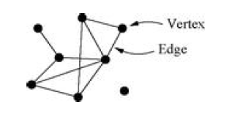
What is a network?
A collection of points joined together in pairs by lines
Points that will be joined together depends on the context
Points: Vertices, nodes, actors …
Lines: Edges, relationship

Slide 3
Modelling networks
There are many systems of interest that can be modeled as networks
Individual parts linked in some way
Internet: A collection of computers linked together by communication network
Human societies: A collection of people linked by acquaintance or social interaction
In the computer network course, we study about the nodes and their communication techniques
Example: TCP/IP

Slide 4
Why are we interested in networks?
Although individual components of a system (e.g., computer machines, people, etc.) and the nature of their interaction are important, of equal importance is the pattern of connections between these components
These patterns significantly affect the performance of the underlying system
The patterns of connections in the Internet affect the routes packets travel through
Patterns in a social network affect the way people obtain information, form opinions, etc.

Slide 5

Why structure is important? (1)
The value of a system does not only depend on its individual components
What is common in pencil and diamond?
They are both made of carbon

Slide 6
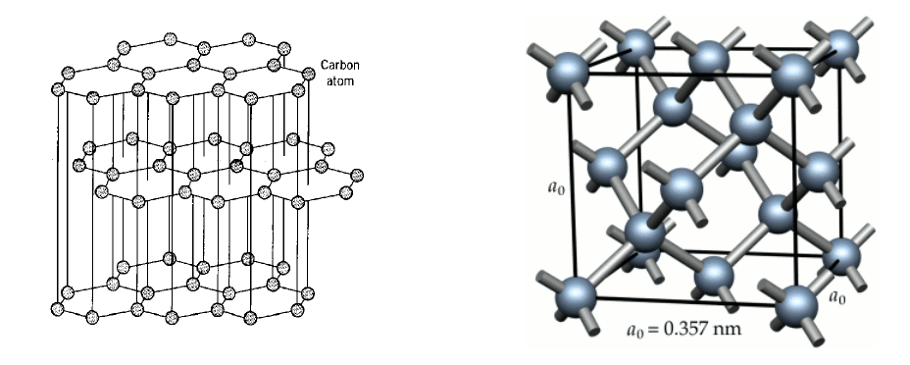
Why structure is important? (2)
What is different between pencil and diamond?
Their structure

Slide 7
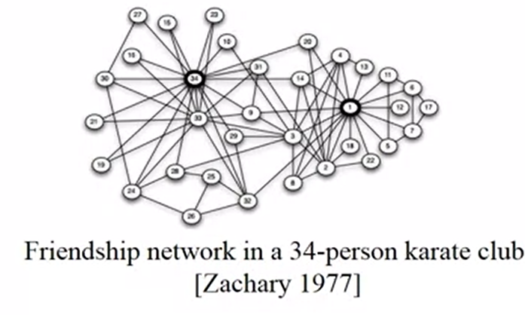
Networks show up everywhere! (1)
Wayne Zachary’s “karate club” network
Edges represent friendship
Network constructed by
direct observation of
interaction among
members
What can you infer from
the network?

Slide 8
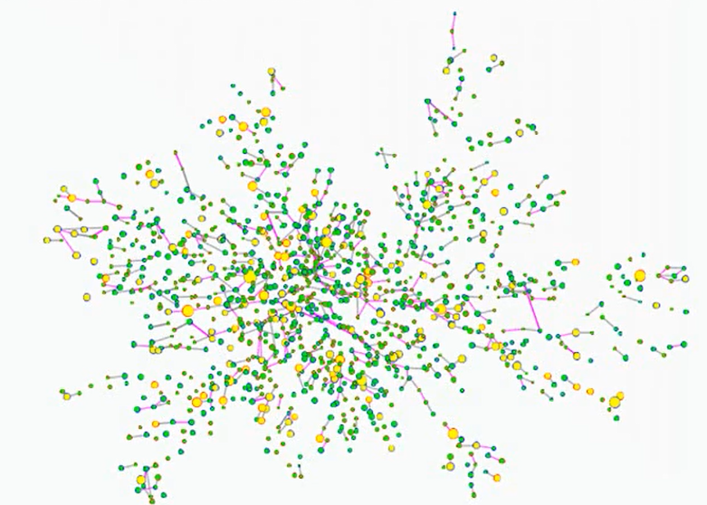
Networks show up everywhere! (2)
Framingham Heart Survey social network
Depicts the spread of obesity and change in ties over 32 years
12067 subjects
Multiple foci
Size, shape and color of nodes have different meaning
What is the relation among the nodes?

Slide 9
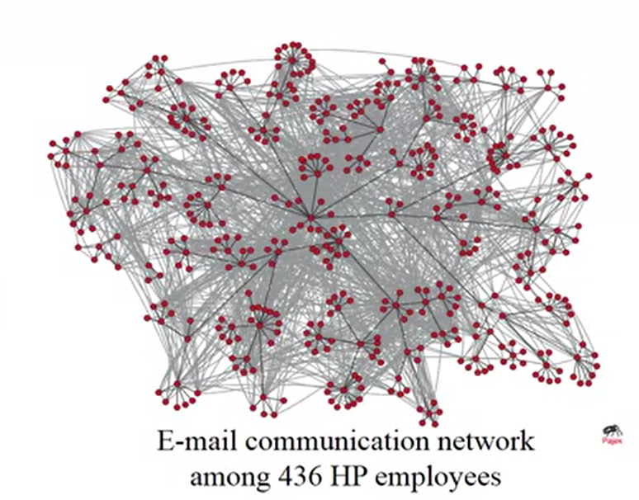
Networks show up everywhere! (3)
If we start a rumour, is it likely to spread in the entire network?
Who are the most influential people in the organization?
Is the karate club likely to spread into two different clubs?

Slide 10
Why network science?
Scientists in a wide variety of fields have developed tools for analyzing, modelling, and understanding network structures
Mathematical, statistical and computational tools
Identify the best connected node, the path between two nodes, predict how a process on a network (e.g., spread of a disease) will take place etc.
These tools work in an abstract level – not considering specific properties of the network examined
General applicability to any system that can be represented as a network

Slide 11
Examples of networks: The Internet
The Internet
Depending on the level of granularity, vertices can be network devices (host machines and routers) or autonomous systems
Edges are physical links between vertices
Studying the Internet structure can help understand and improve the performance
How do we route packets over the Internet?
How resilient is the Internet in the failure of nodes/edges?
Which edge’s capacity should we boost?

Slide 12
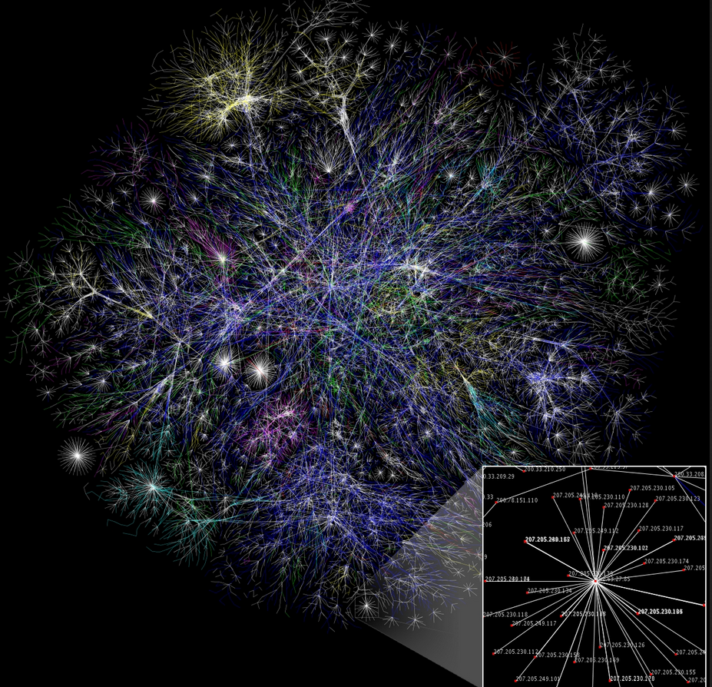
The Internet
Wikipedia
Partial map of the Internet as on January 15, 2005
Edge length : delay
Edge Color: domain
Nodes: IP address

Slide 13
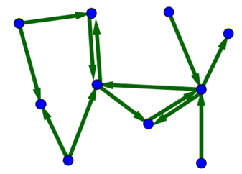
Examples of networks: WWW
The World Wide Web
Often confused with the Internet but they are different!
The Web is a network of information stored in webpages
Nodes are the webpages
Edges are the hyperlinks between the pages
The structure of this network is one of the major factors that Google exploits in its search engine
Directed edges

Slide 14
Examples of networks: Social Networks
Social networks
Network of people
Edges can represent friendships, relative relations, co-locations etc.
Long tradition in network analysis
Traditionally social network studies were based on small scale networks
Online social media have provided network data on previously unreachable scale

Slide 15
Examples of networks: Disease network
Human Disease Network (HDN)
Vertices are humans (disorders)
Edge from A to B, iff B infects A
at least one gene in which mutations are associated with both disorders
Can help understand how disease infection spreads
Prevalence of a disease type in a location
Properties of HDN
Disconnected nodes/small clusters
disorders have a distinct and unique genetic origin
Many connections b/w nodes and disorder class
genetic origins of most diseases are shared

Slide 16
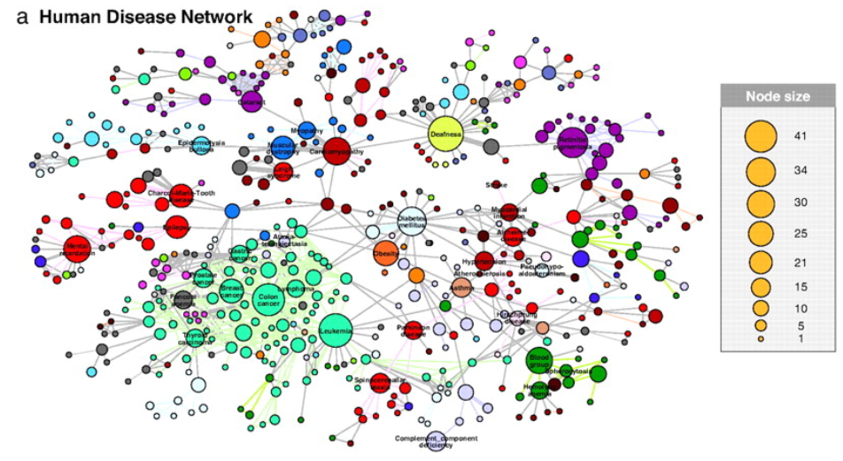
Disease network
HDN generated independently of disorder class
However, results in clusters according to major disorders
Difference b/w different classes
Cancer clusters are tightly interconnected
Kwang-Il Goh, et. al. (2007)

Slide 17
Examples of networks
Transportation networks
Airline routes, road and rail networks
Road networks (usually)
Vertices: road intersections
Edges: roads
Rail networks
Vertices: locations
Edges: between locations that are connected with a single train
More general bipartite networks
Network theory can be applied to identify the “optimal” structure of a transportation network for a pre-specified objective

Slide 18
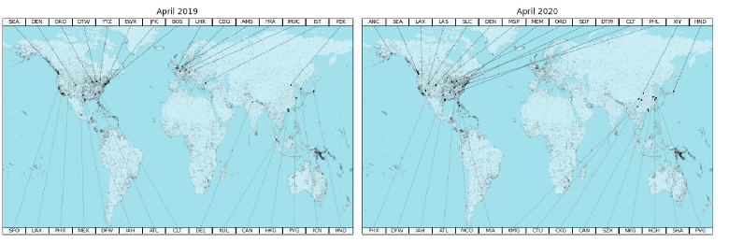
Examples of Networks: Flight connectivity
World wide airport based on their connectivity
COVID-19 pandemic and air transportation: Successfully navigating … - Xiaoqian Sun, et. al. (2021)

Slide 19
Examples of networks: Delivery Networks
Delivery and distribution networks
Gas pipelines, water and sewerage lines, routes used by the post office and package delivery and cargo companies
Gas distribution network
Edges: pipelines
Vertices: intersections of pipelines
Pumping, switching and storage facilities and refineries
River networks
Blood vessels in animals and plants

Slide 20
Examples of networks: Affiliation network
Affiliation networks
Two types of vertices
Connections allowed only among different types of vertices
E.g., board of directors of companies and their members, people and locations they visit etc.
Figure: Women connected by
common attendance at social
events

Slide 21
Examples of networks: citation network
Citation networks
Vertices are papers
An edge exists from paper A to paper B, iff A cites B
Network analysis can be used to identify influential papers
Bibliometrics
Recommender networks
Represent people’s preferences for things
E.g., preference on certain products sold by a retailer

Slide 22
What do we study in networks?
Structure and evolution
What is the structure of a network?
Why and how did it become to have such a structure?
Processes and dynamics
How does information disseminate?
How do diseases spread?

Slide 23
Properties of networks (1)
Network theory has developed a large number of tools that can be used to describe and understand networks
Centrality: quantification of the importance of a vertex (or even an edge)
Various definitions capture different aspects and can be useful in different contexts
Degree, eigenvector, Katz, PageRank etc.
Geodesic distance: minimum number of edges one would have to traverse in order to get from one vertex to the other
Implications on how fast things travel in the network

Slide 24
Properties of networks (2)
Network theory includes also a number of concepts of practical importance
The notion of hubs
A small number of vertices with extremely high degree
What are their implications in networks?
Small-world effect
On average geodesic distances are much smaller compared to the size of the network
Repercussions with regards to information diffusion
Communities in networks
The way a network breaks to communities might reveal information for the network (e.g., an organization) that are not easy to see without network data

Slide 25
The tale of networks: Konigsberg bridges
Seven bridges of Konigsberg
Konigsberg was built on the banks of the river Pregel and on two islands that lie midstream
Seven bridges connected the land masses
Does there exist any walking route that crosses all seven bridges exactly once?
Leonhard Euler mapped the problem to a graph and proved that this is impossible
Foundations of graph theory

Slide 26
The tale of networks: Alpha model
“the friends of my friends are likely to become my friends too“.
Alpha model
How do small world networks appear?
What are the rules that people follow when making friends?
People introduce their friends to each other
The more common neighbors two vertices share, the more probable they are to connect

Slide 27
The tale of networks: Fitness model
The fitness model
Albert-Laszlo Barabasi and Reka Albert, realized that networks grow, and as they grow the nodes with more links get the bulk of the new links
Preferential attachment
As networks evolve hubs are formed
Power law
Later Barabasi capitalized on the similarities that these models had with the Bose-Einstein equation
Along with preferential attachment he introduced the attractiveness of a vertex

Slide 28
The tale of networks: Erdős–Rényi (ER) graphs
Random networks
Erdos extensively studied networks that form randomly
Two vertices connect uniformly at random
Erdos realized that if networks develop randomly, they are highly efficient
Even with few connections on average per link, the network can be connected with small paths
Erdos laid the foundations modern network theory

Slide 29
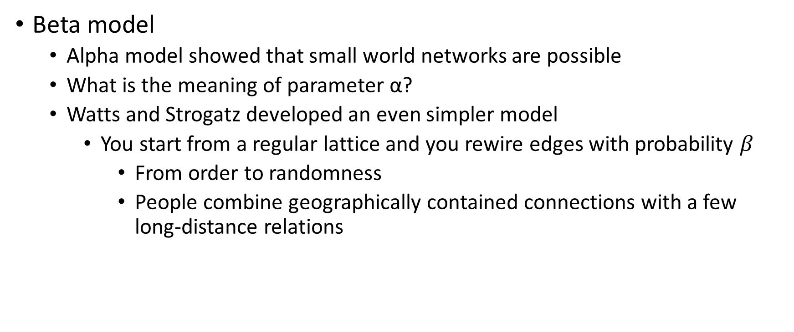
The tale of networks: Beta model
Beta model
Alpha model showed that small world networks are possible
What is the meaning of parameter α?
Watts and Strogatz developed an even simpler model
You start from a regular lattice and you rewire edges with probability $β$
From order to randomness
People combine geographically contained connections with a few long-distance relations

Slide 30
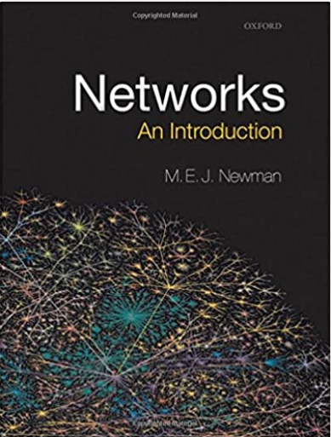
Course Administrivia
https://www.iitg.ac.in/ashok/MA653
Please check the site frequently for updates
Required Text
M.E.J. Newman, Networks - An introduction,
2nd Ed,, Oxford Univ. Press, 2018.
References
Albert-László Barabási, Network Science,
1st Ed, Cambridge Univ. Press, 2016

Slide 31
Course Outline
Module # | Topic | Remarks
1 | Introduction/Mathematics of networks
2 | Measures and Metrics
3 | Large-scale structure of networks
4 | Graph Partitioning | 13 Feb 2024: Quiz 1
5 | Random Graphs
6 | Random Graphs with general degree distribution
7 | Models of Network Formation
8 | Other network model: Small world phenomena
9 | Percolation
10 | Epidemics on Networks | 16 Apr 2023: Quiz 2
11 | Network Search

Slide 32
Grading
Quiz/Assignment /Class Participation : 20 points
2 quizzes have been planned
Mid Semester : 30 points
End-Semester : 50 points

